Slide 1

Research in Software Engineering

Slide 2
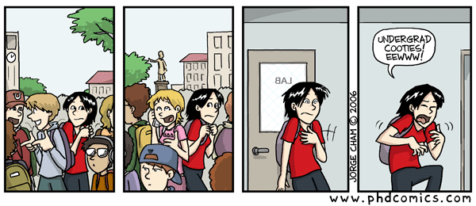
It is grad school application season!

Slide 3
Research: Pursuit of fundamental knowledge
Engineering: Building an innovative system
*Many things span both
**Software engineering is often very applied

Slide 4
Software Correctness
Software Efficiency
Does it do what it is supposed to?
Does it run performantly?
Software Cost
Is it affordable to develop?

Slide 5
A few topics in SE research
Formal methods
Program analysis
Mining repositories
Program synthesis
Automated repair
Qualitative studies
Code search
Program comprehension
Code transformation
Automated testing
Metrics & analytics
Software security
Smell detection
CS Education
Documentation generation
Development tools

Slide 6
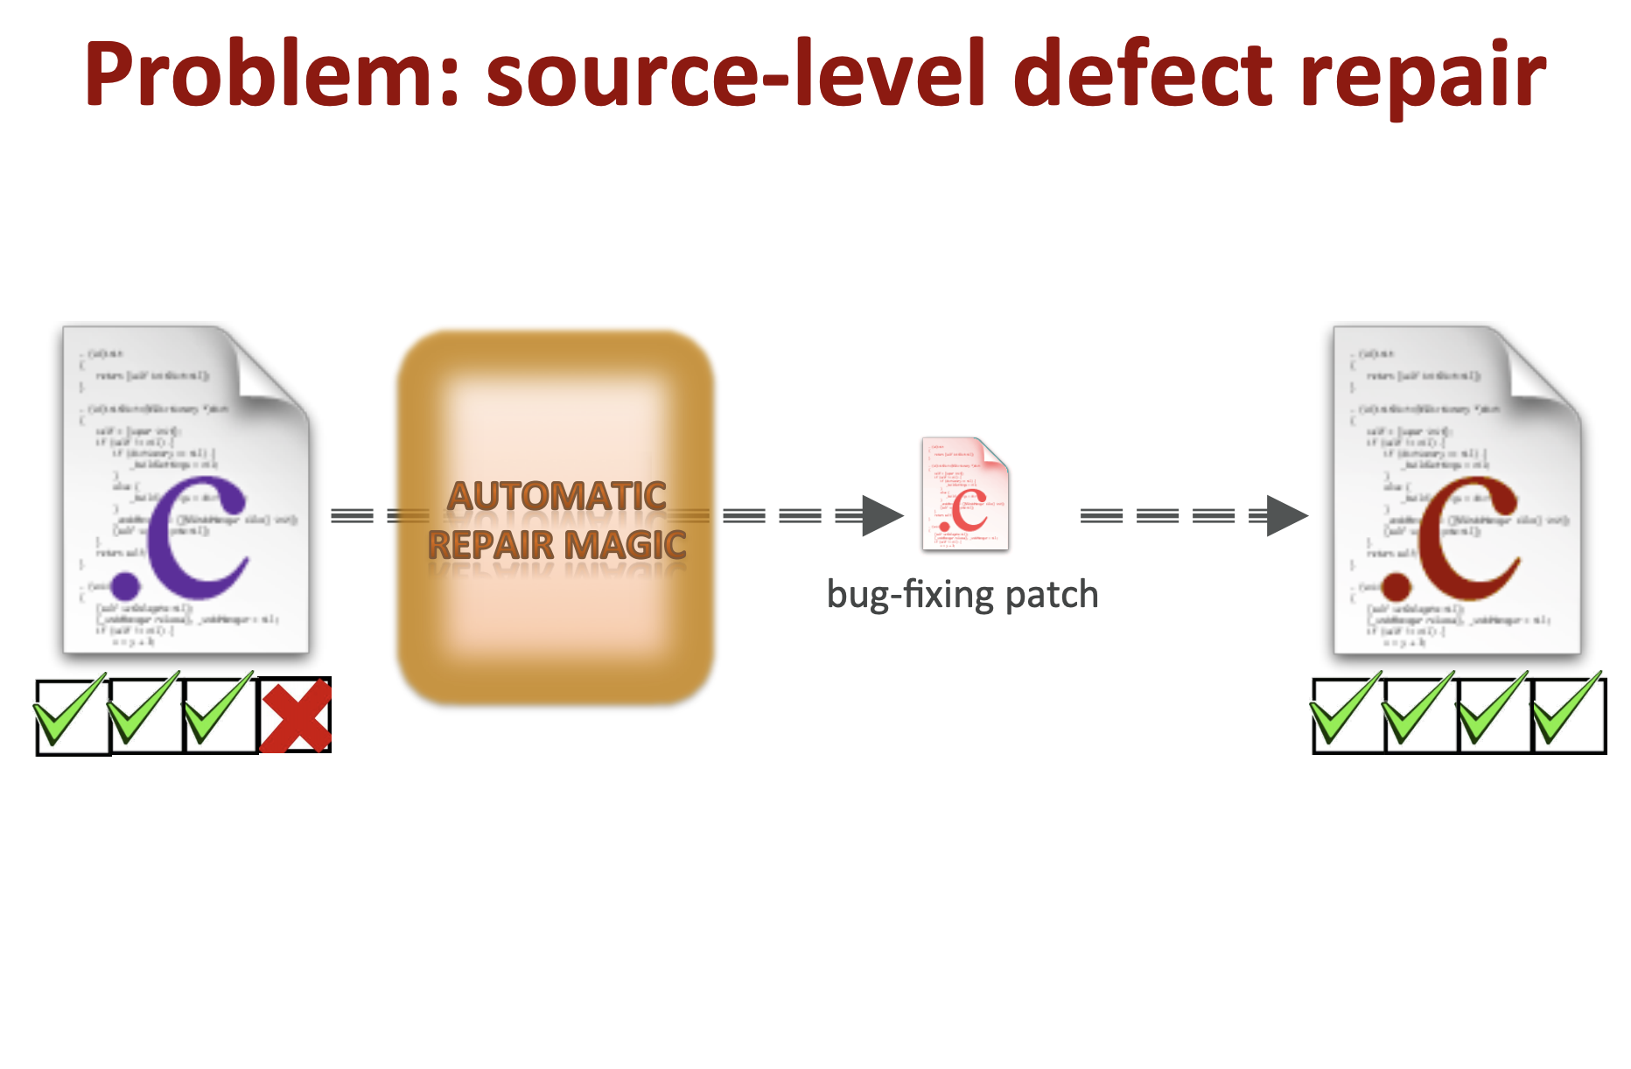
Automated Program Repair
https://squareslab.github.io/genprog-code/
Notes:
These next slides taken from Claire Le Gous’s talk at Papers We Love.

Slide 7
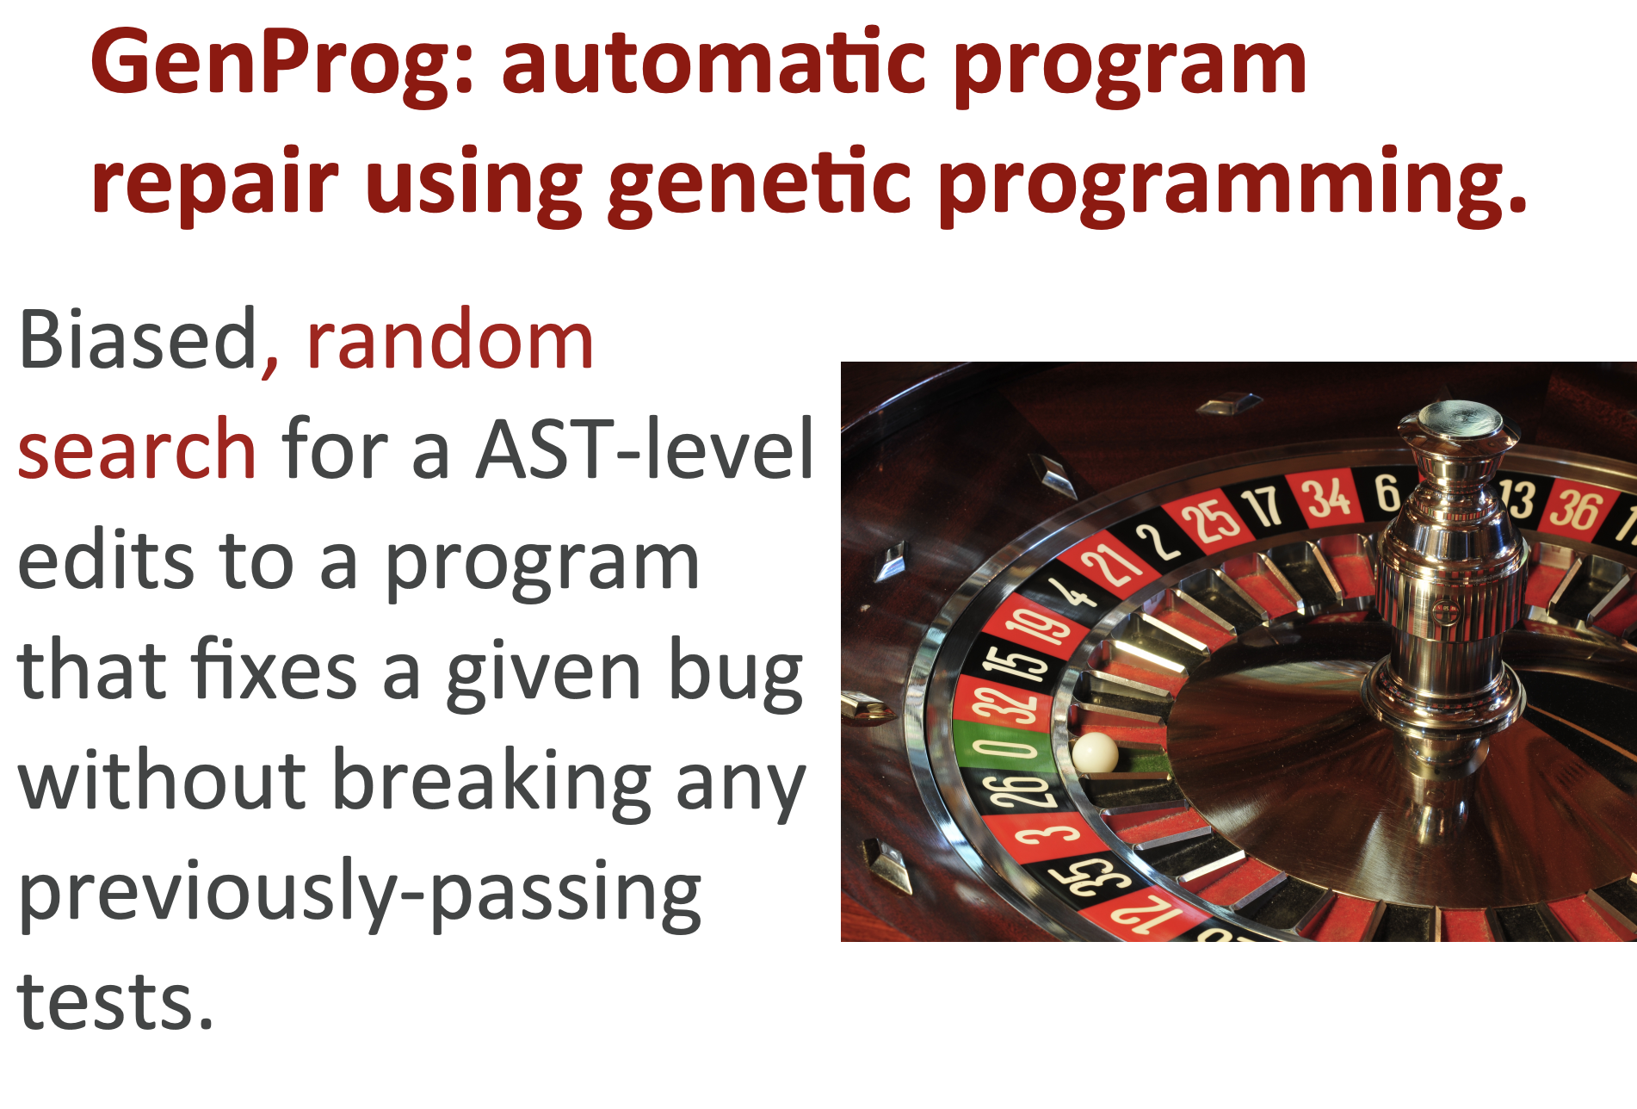
https://squareslab.github.io/genprog-code/

Slide 8
Genetic Programming… what is it?

Slide 9
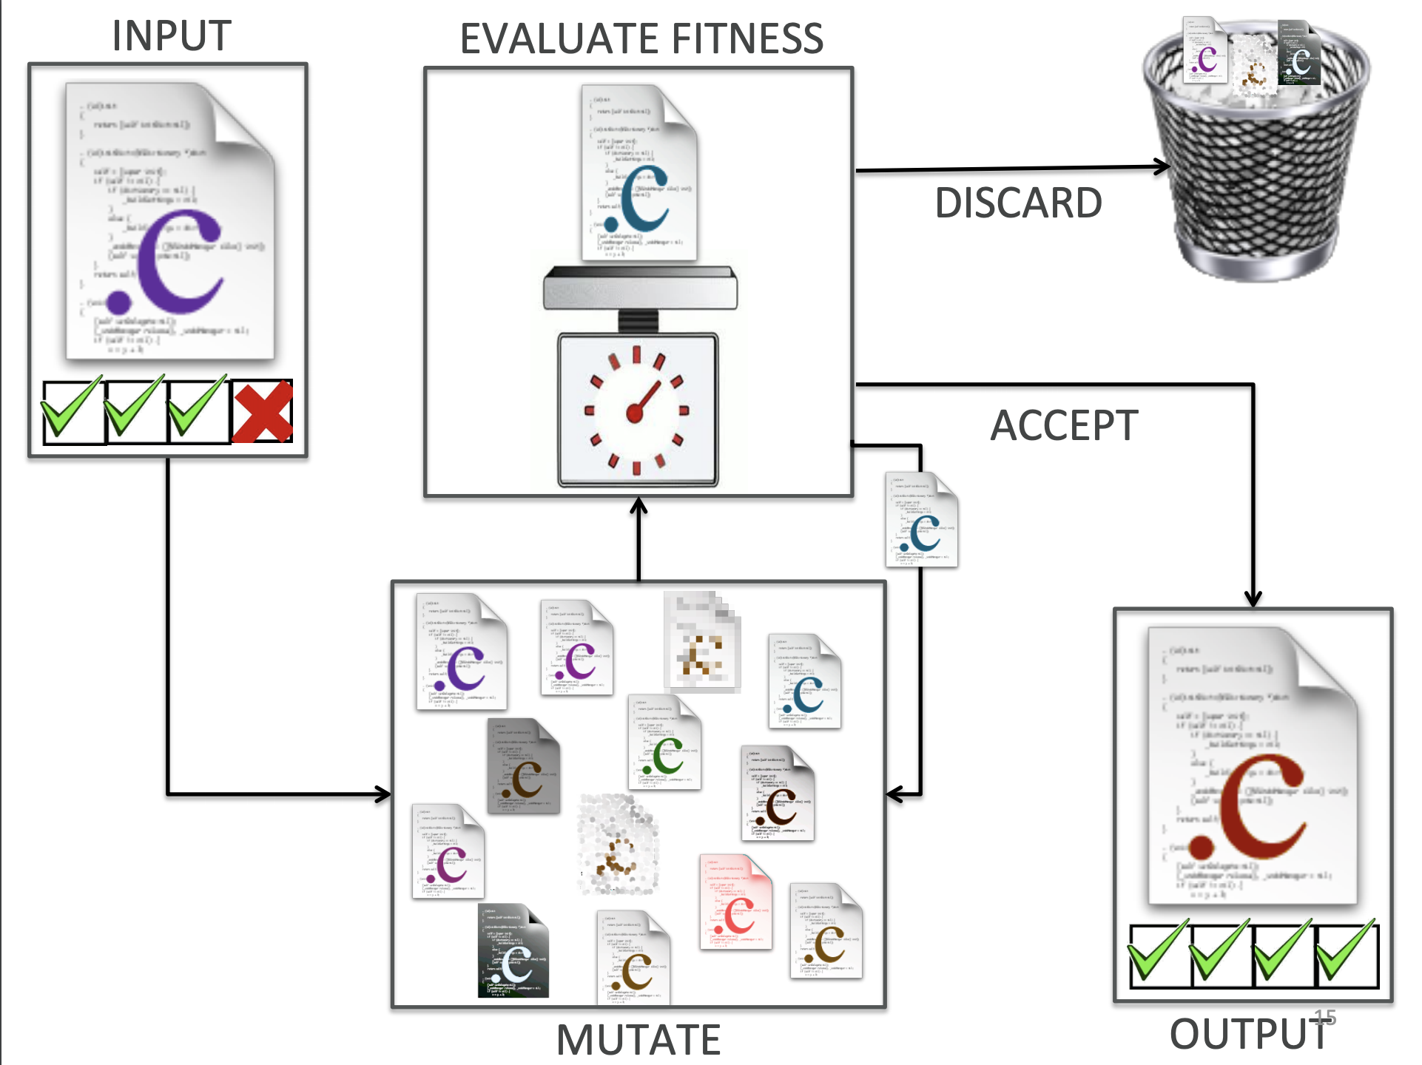
https://squareslab.github.io/genprog-code/

Slide 10
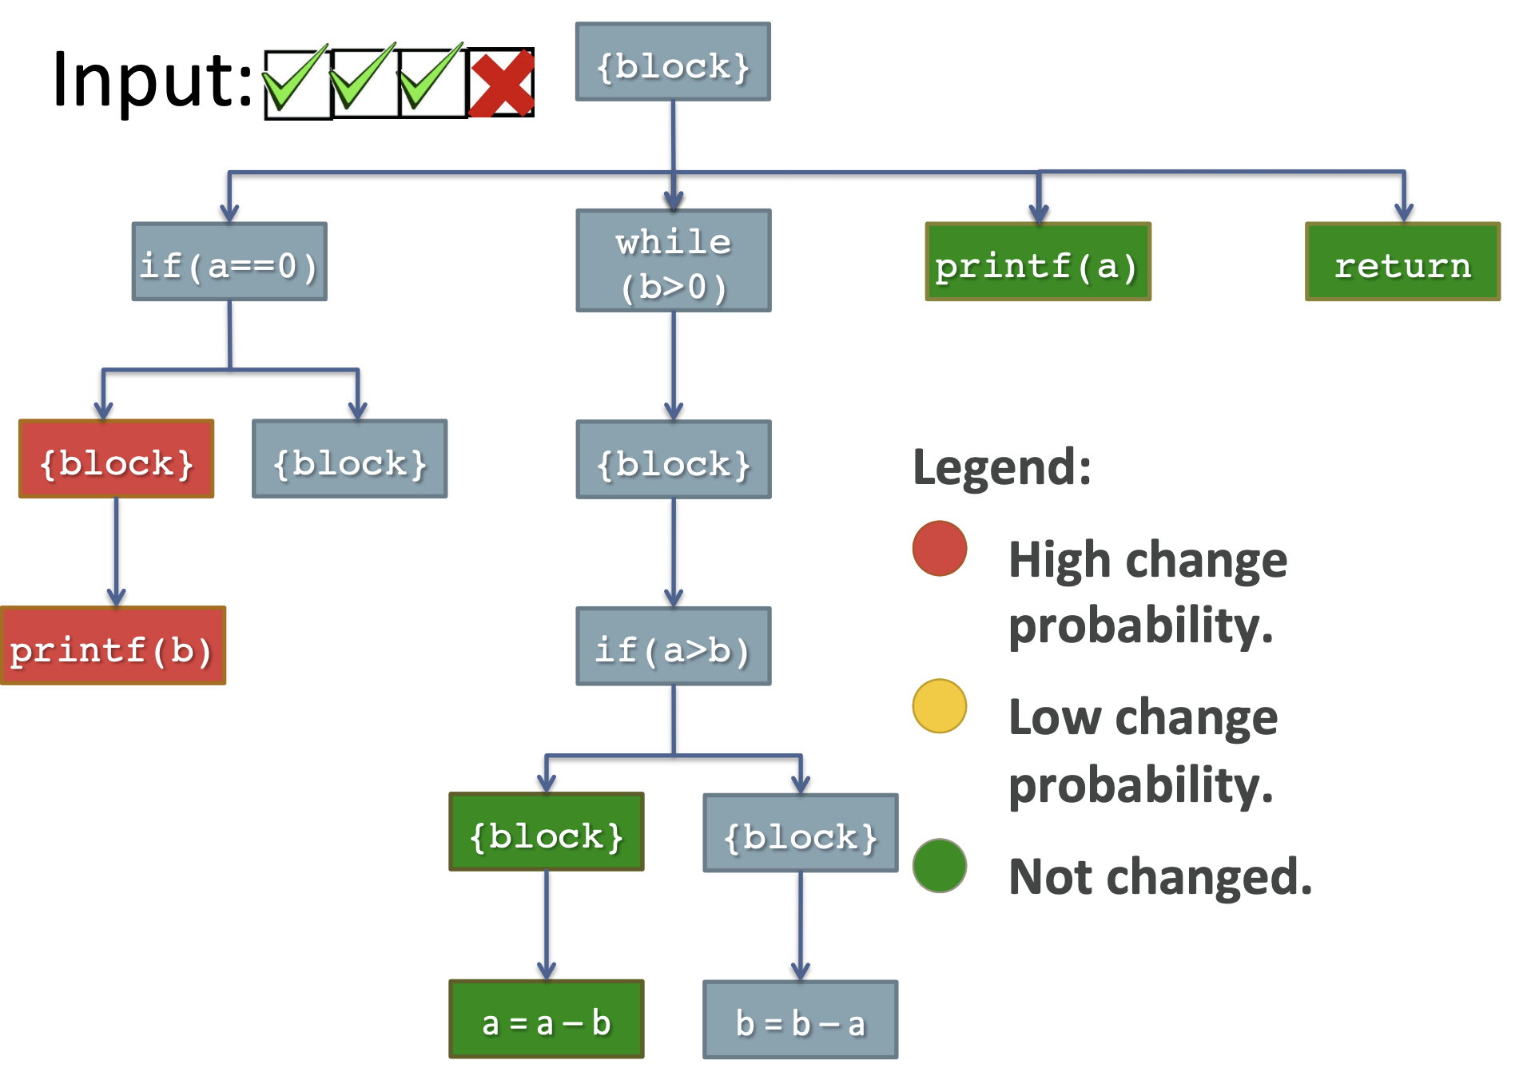
https://squareslab.github.io/genprog-code/

Slide 11
Results?
Can fix a lot of bugs!
However, code quality may be low…
Highly dependent on quality of tests

Slide 12
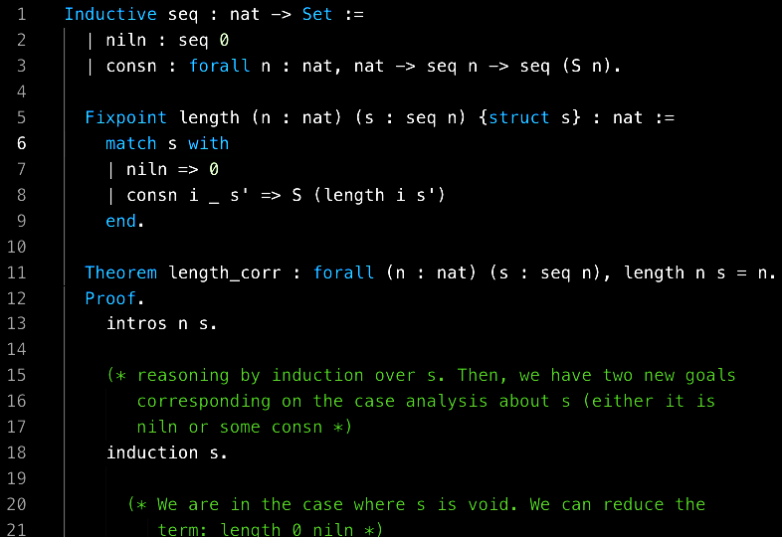
Formal methods
What can we prove about a program?
Uses math and formal logic
Theorem provers help you write proofs

Slide 13
Metrics & analytics
How to measure software complexity?
Lines of code
Cyclomatic complexity
How to analyze software once deployed?
Bug reports
Telemetry

Slide 14
Mining code repositories
Analyze large sets of code to empirically understand...
how code is structured in real projects
how bugs are fixed
what can predict bugs
what is discussed during code reviews
“Code churn” correlates
with bugs

Slide 15
Qualitative studies of developers
Apply social science methods to software engineering
What can be learned from observing devs?
How do devs spend their time coding?
35% of time spent navigating code
Information needs
Where is this value being changed?
What function is doing this?
How do devs refactor?
Usually manually
Frequently
How do experts/novices debug?
Experts go top-down and follow structure
Novices read line by line

Slide 16
Code search
Code projects are huge… how can we search it?
Search by keywords?
Variable and function names are hard to guess
Utilize synonyms?
But code structure is important!
NLP? ML?
Most code searches fail!
Still an open problem

Slide 17
Developer tools
Some things are nearly impossible to automate…
How to make devs more productive with better tools?
Provide additional information
Reduce cost to perform some action

Slide 18
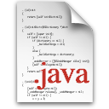
Developers navigate… a lot
35% time navigating [Ko et al. ICSE’05]
Navigate 2–5 times per minute [Fritz et al. FSE’14, Piorkowski ICSME’15]
50% time foraging for information [Piorkowski et al. CHI’12]

Slide 19
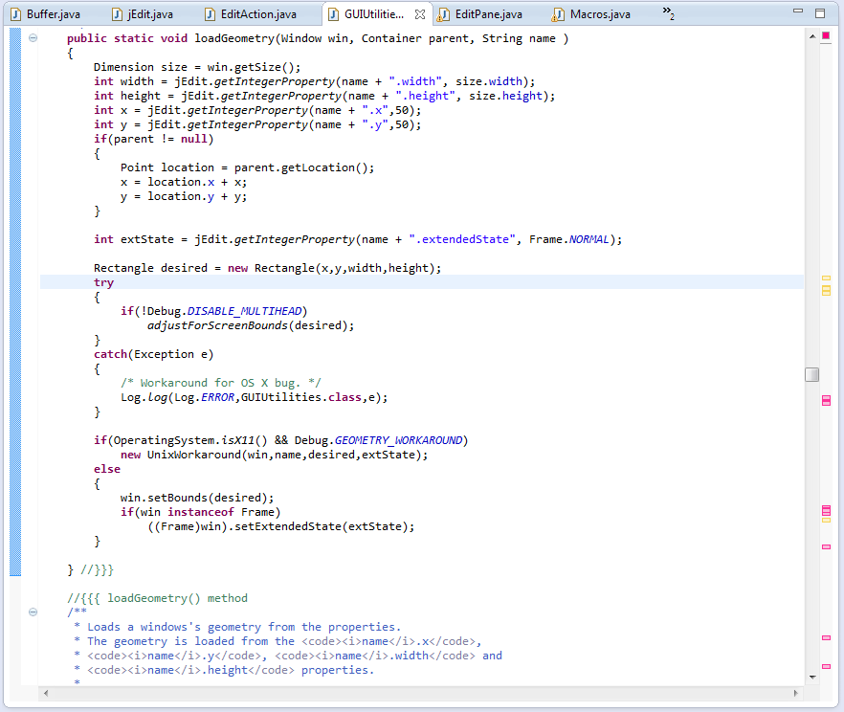
Tab-Based Editors
Navigate within files by scrolling
Open multiple files using tabs

Slide 20
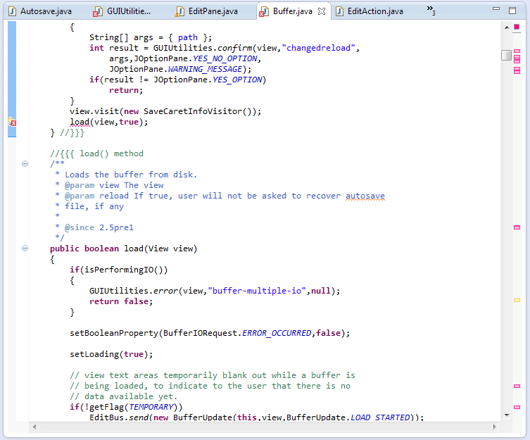
Problems with Tab-Based Editors
Elided tabs
Scrolling through irrelevant code
Tab management
Juxtaposition tedious
Relevant code
Irrelevant code

Slide 21
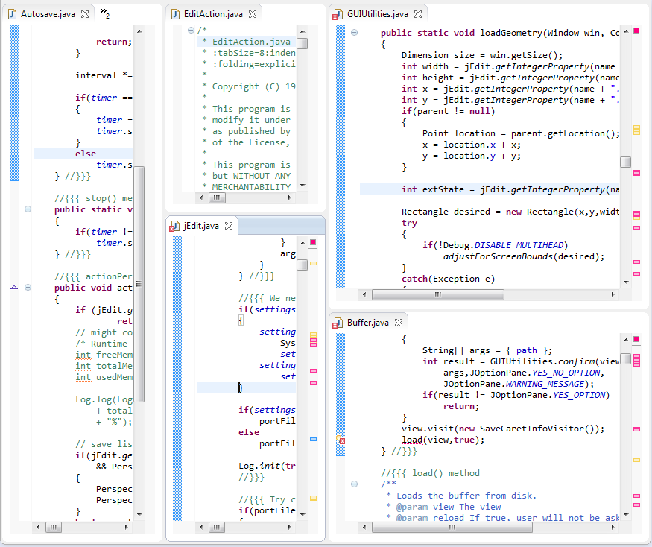
Problems with Tab-Based Editors
Scrolling through irrelevant code
Tab management
Juxtaposition tedious
Like a“jigsaw puzzle”
[Bragdon ’09]

Slide 22
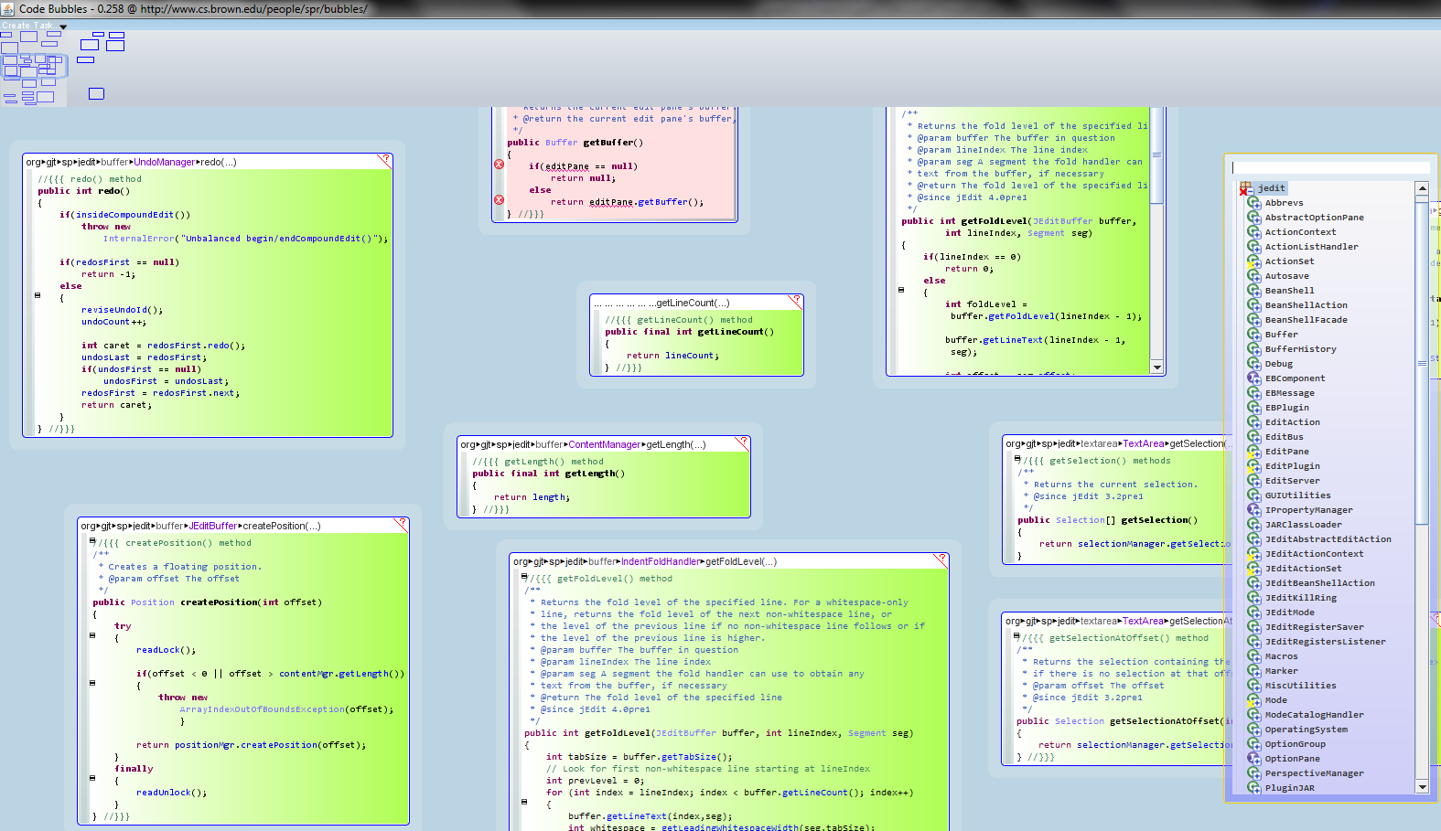
Canvas-Based Editors

Slide 23
Patchworks
https://youtu.be/tGkGjZI21Mw
https://youtu.be/GwcxDZT3pXE

Slide 24
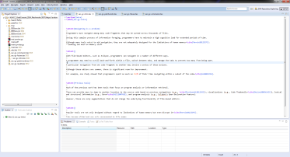

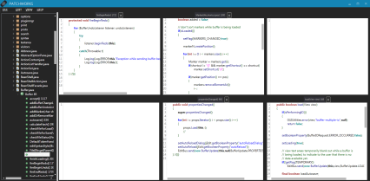
Preliminary User Study
Three treatments
15 participants
2 treatments each
Open source codebase
Tasks:
Open and arrange 30 code fragments
Perform 10 timed navigations
Eclipse
Code Bubbles
Patchworks

Slide 25
Results: Arranging Time

Slide 26
Results: Navigation Time

Slide 27
Results: Navigation Mistakes

Slide 28
Issues with this study design?
Artificial tasks
Student developers
Unknown code
Unfamiliar tools
Observation effect

Slide 29
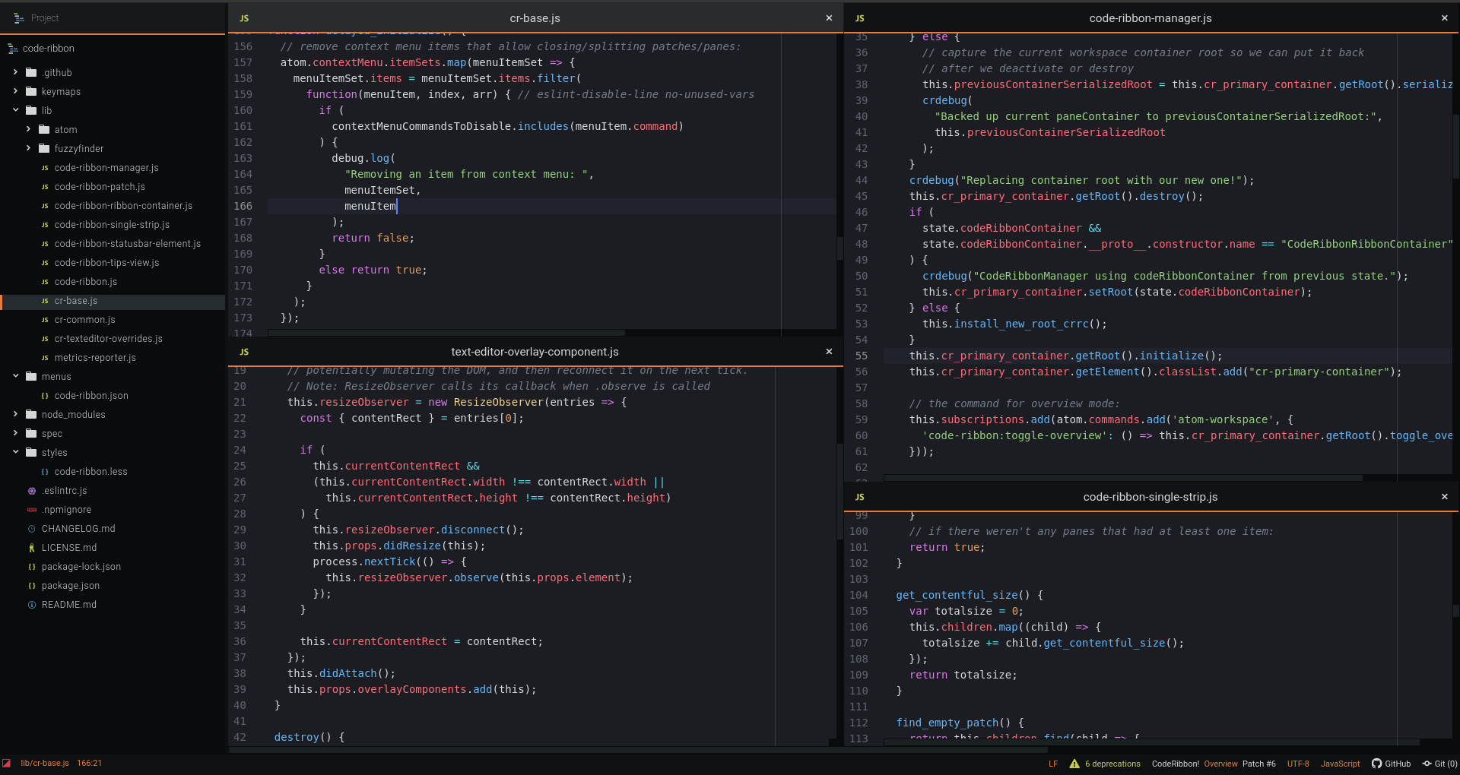
CodeRibbon
Open source Atom plugin

Slide 30
Navigating the ribbon

Slide 31
Zooming out on the ribbon

Slide 32
Whyline
Formative studies found devs often ask…
Why does this happen?
Why does this not happen?
Code editors do not provide a way to ask questions
Devs must run app and traverse through the code

Slide 33
Whyline
Formative studies found devs often ask…
Why does this happen?
Why does this not happen?
Code editors do not provide a way to ask questions
Devs must run app and traverse through the code
https://youtu.be/t6gVZ-qZ4sI
Notes:
Figure from Myers & Ko 2009 CHI

Slide 34
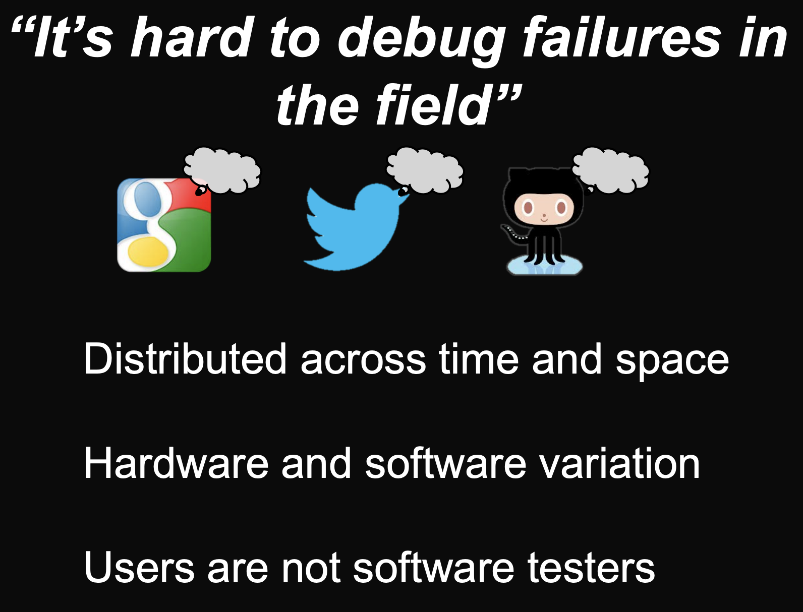
https://homes.cs.washington.edu/~mernst/pubs/record-replay-uist2013-slides.pdf
Notes:
Brian Burg et al. 2013 UIST

Slide 35
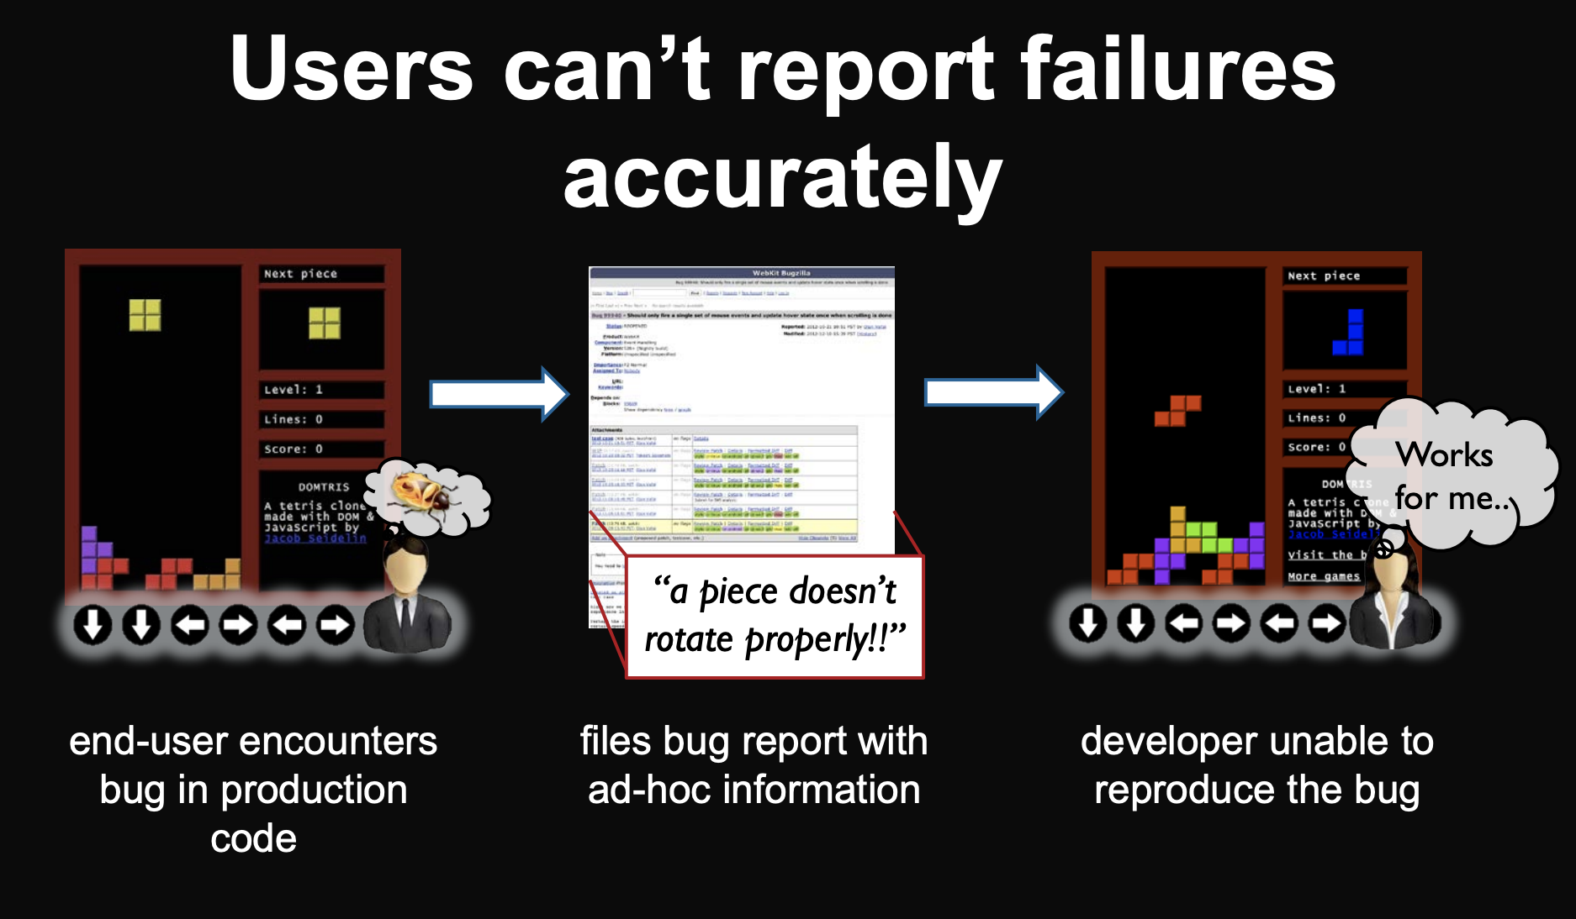
https://homes.cs.washington.edu/~mernst/pubs/record-replay-uist2013-slides.pdf
Notes:
Brian Burg et al. 2013 UIST

Slide 36
Timelapse
Record & play back interactive behaviors in web apps
https://youtu.be/ugHAzyQ6H00

Slide 37
Ever use Undo?
Devs frequently Undo/Redo
Need to see previous version
Need to revert changes
Dangerous: Might lose previous version!
Difficult: Can’t see multiple versions

Slide 38
Azurite
https://youtu.be/blbIBdlUGIc
Notes:
http://www.cs.cmu.edu/~azurite/

Slide 39

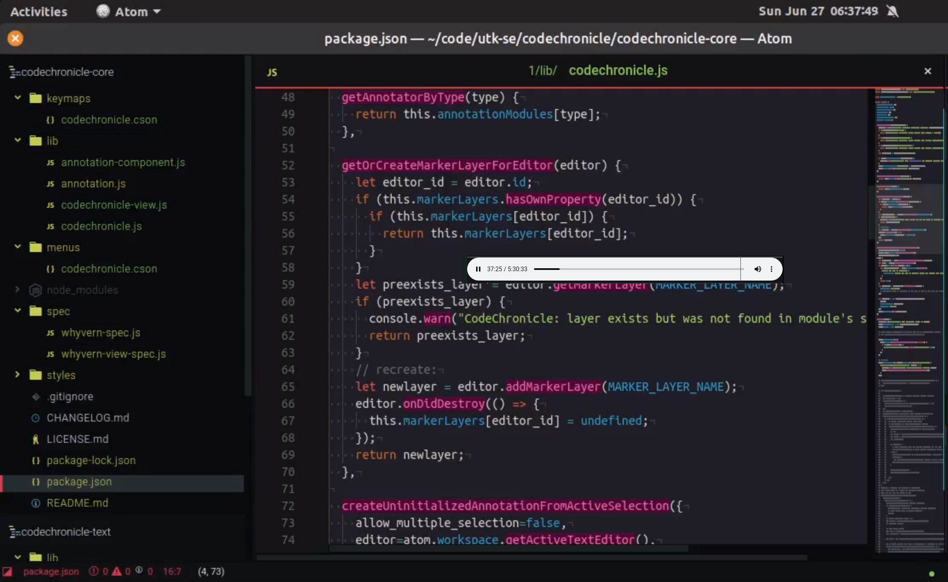
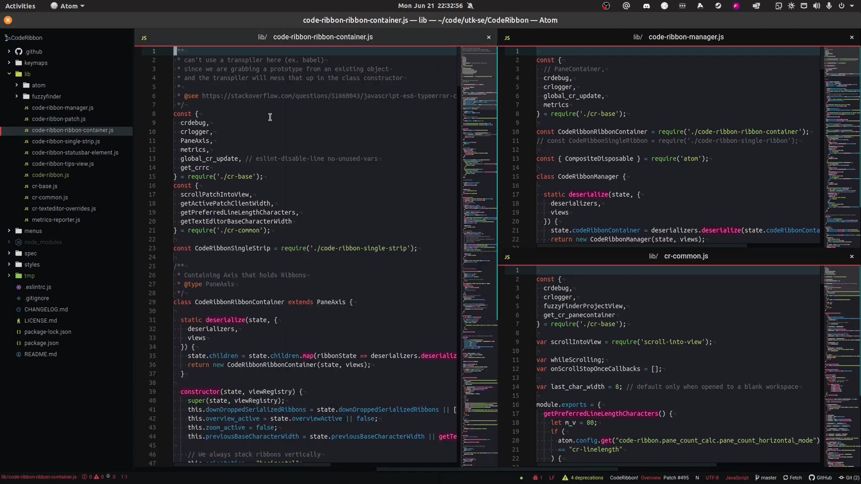
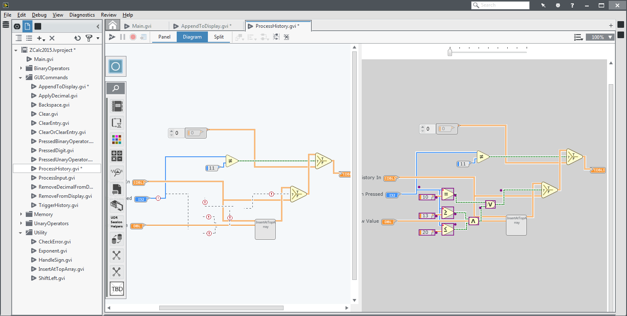
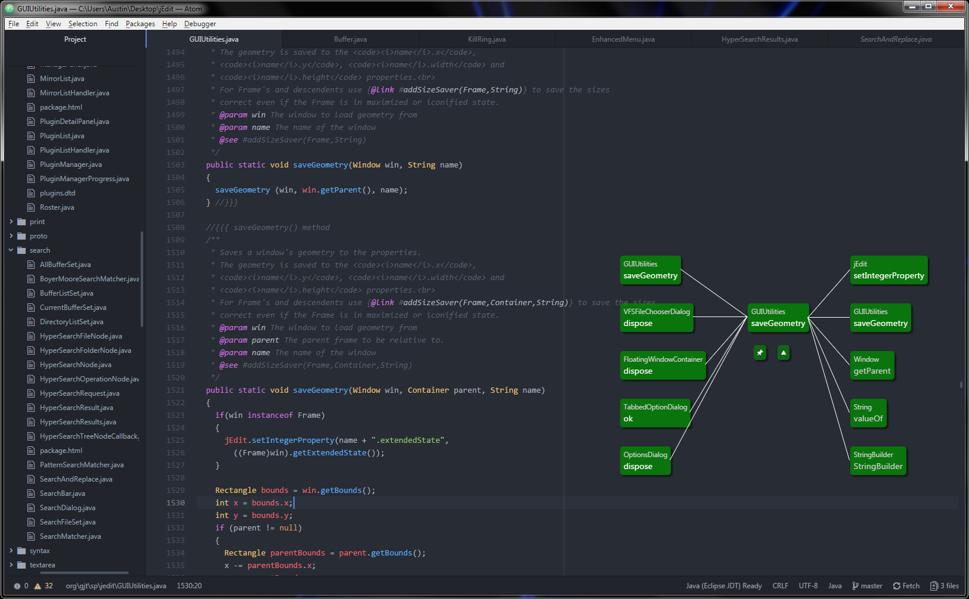
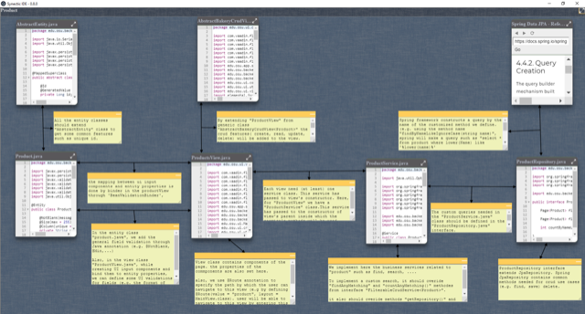
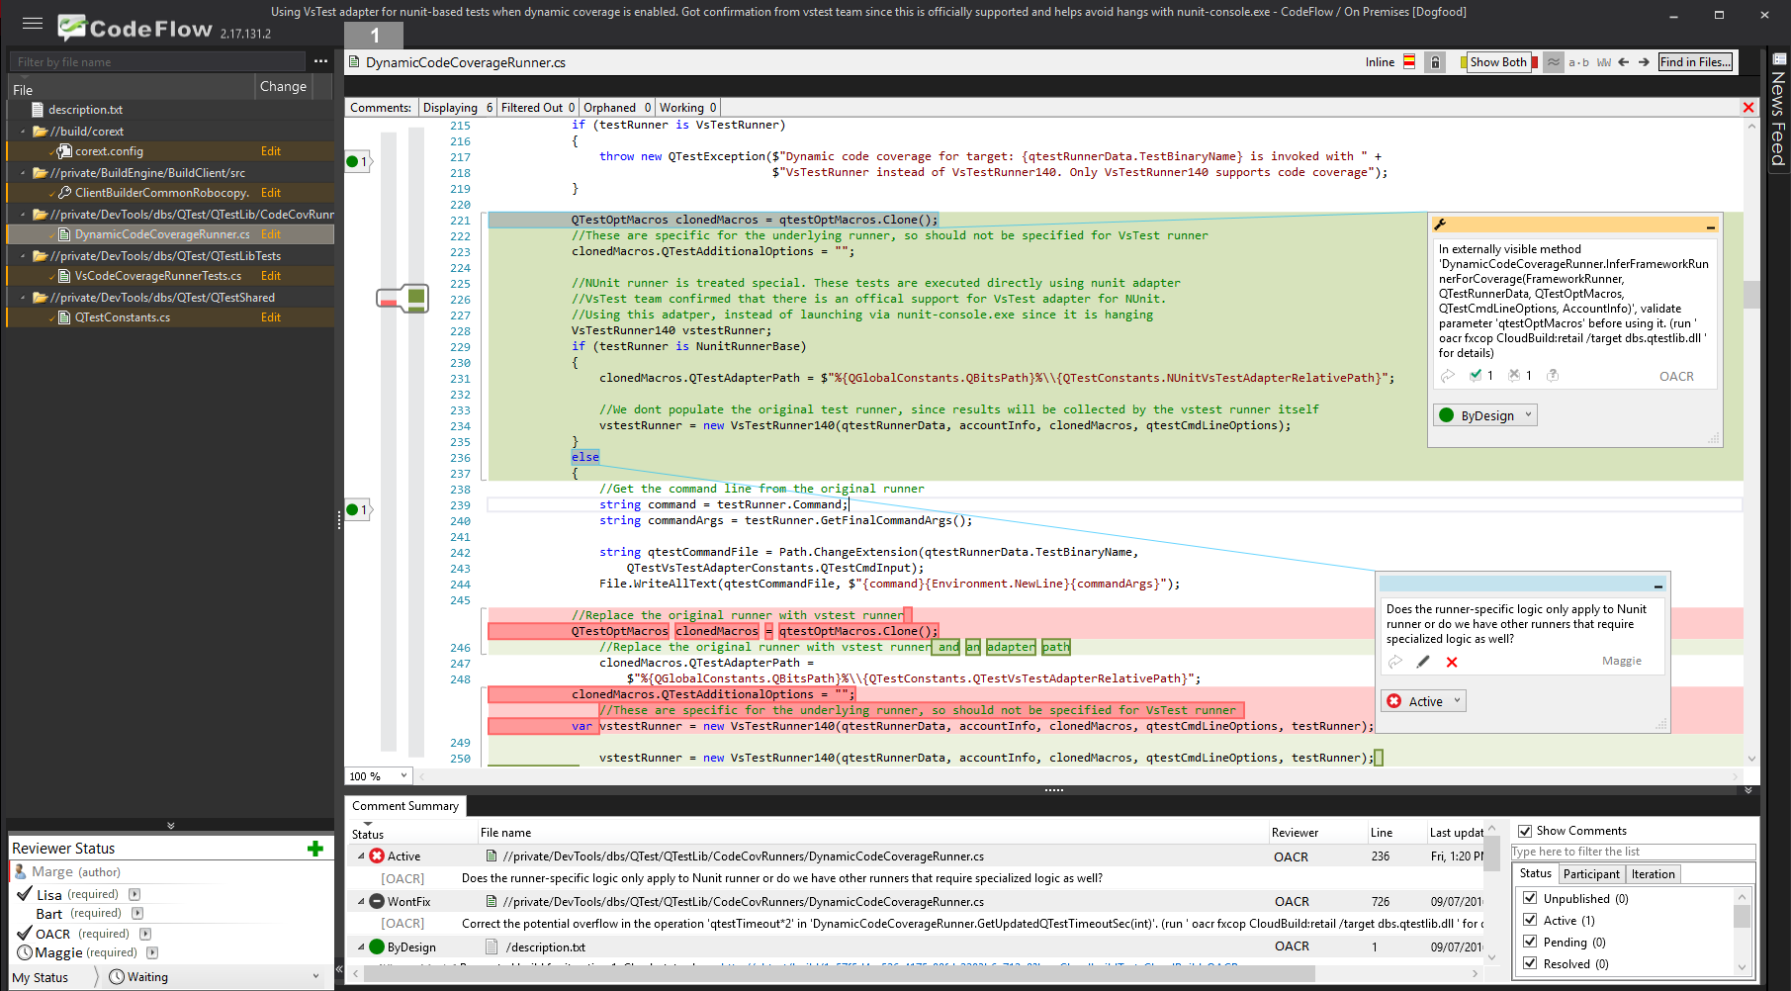
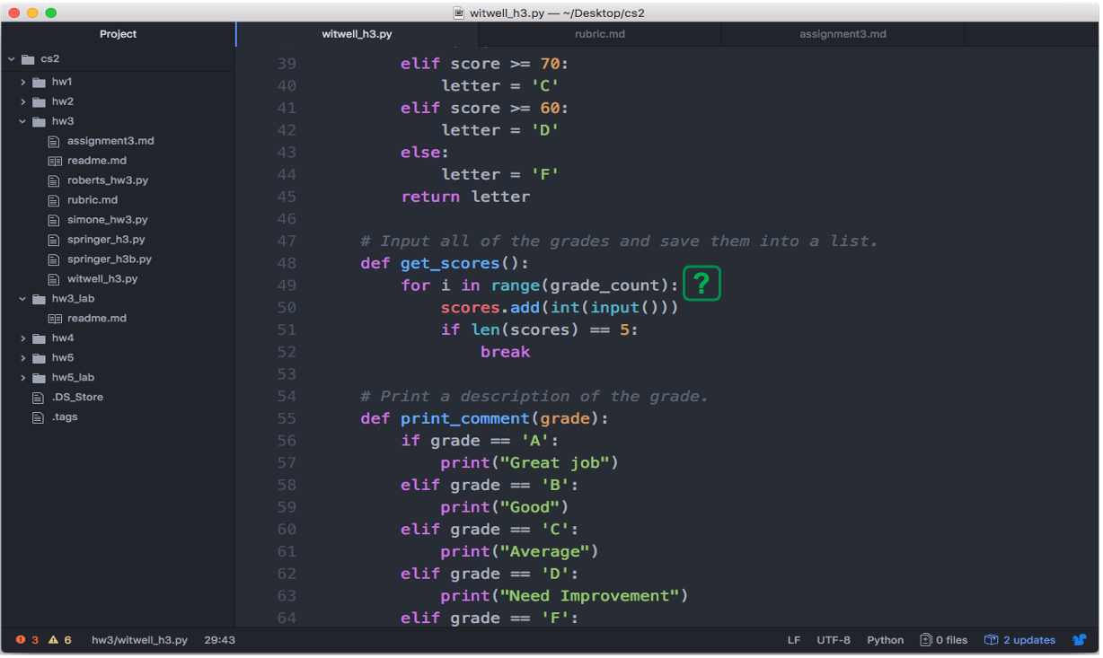
Quick start guide to human factors of software engineering
https://web.eecs.utk.edu/~azh/blog/guidehciseresearch.html

